Slide 1

Medical Letter Site License
Essentials
Must know features users love to use

Slide 2
Medical Letter Essentials: The Basics
Electronic Table of Contents
Reference Tables
Continuing Medical Education – CME/CE
Conclusions
Mobile Apps

Slide 3
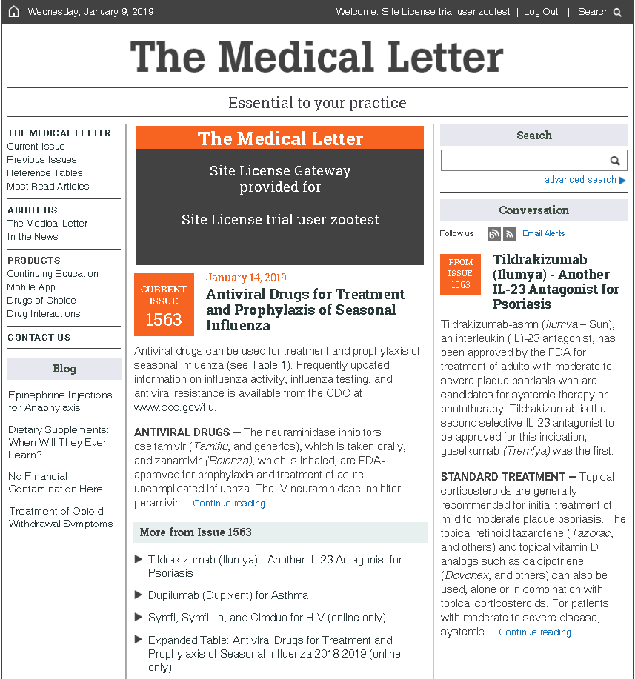
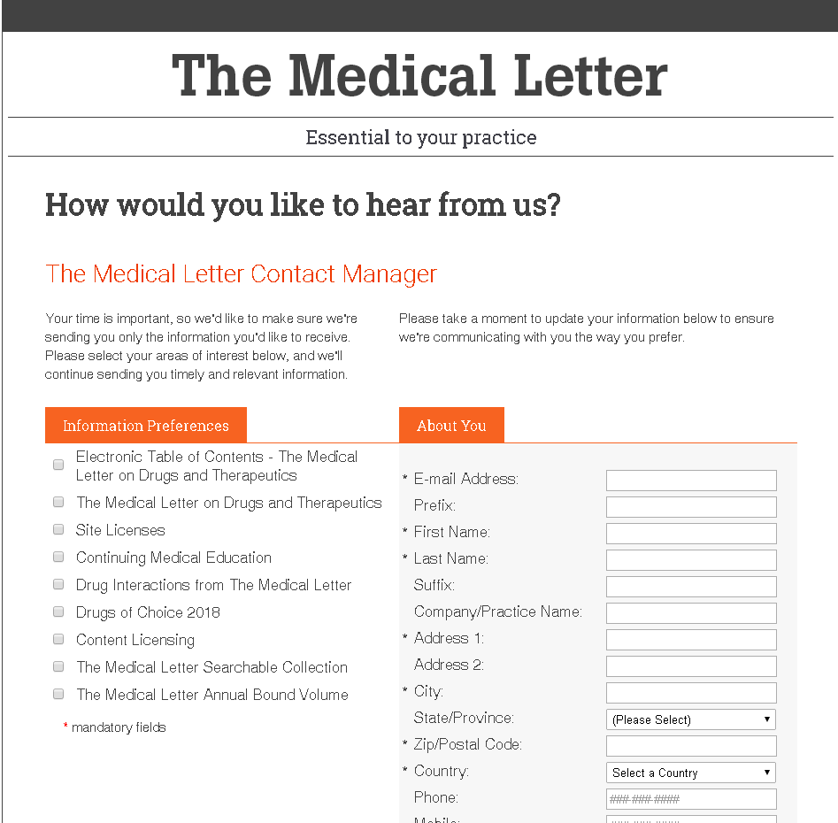
Essential #1: Sign up for Electronic Table of Contents
Stay current on new drugs & changes in therapeutics
Select Table of Contents & complete form
Site License Gateway
Click Email alerts

Slide 4
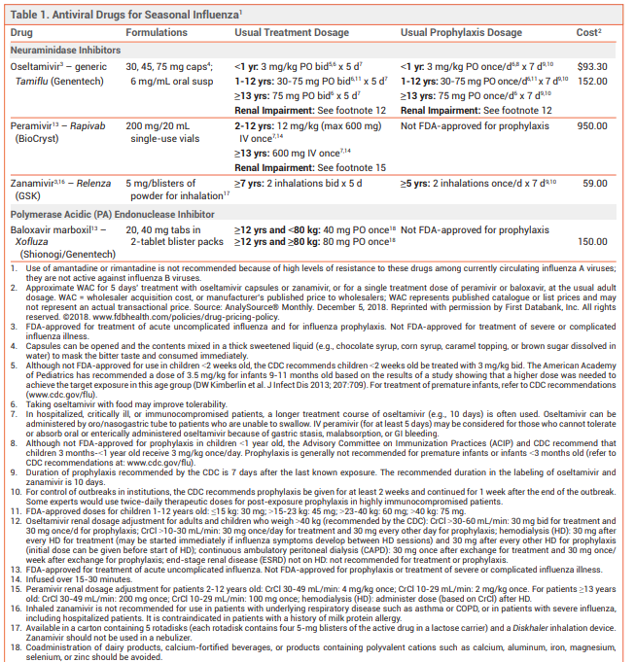

Essential #2: Table Tips
Quickly find manufacturer, dosage & costs for easy reference
Wholesaler Acquisition Cost or Manufacturer’s Publishing Pricing
Manufacturer
Recommended Dosage

Slide 5
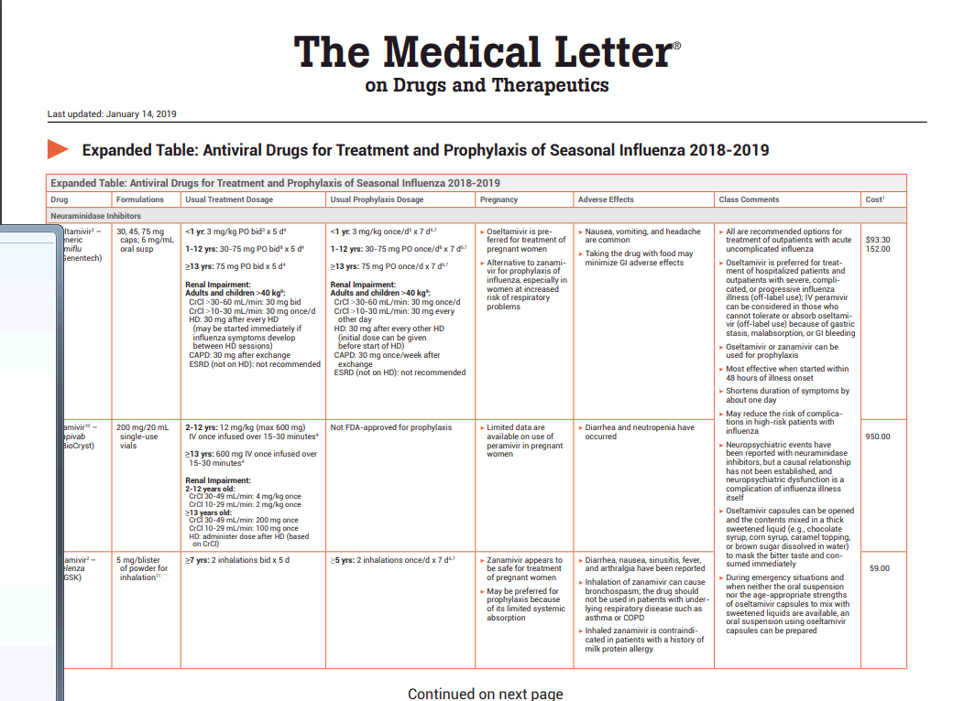
Table Tip 2: View the Expanded Table for Adverse Effects and Valuable Comments
Expand the Table for More Detail

Slide 6
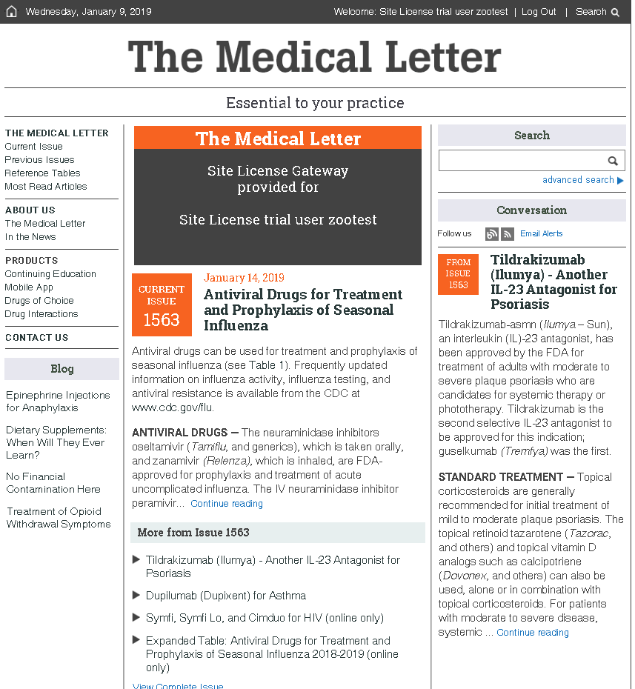
Essential #3: Continuing Medical Education
Earn up to 52 CME/CE credits per year and ABIM MOC points. Accredited by ACCME, AAFP, AAPA and ACPE.
Site License Gateway
Access free CME from the
Gateway home page

Slide 7
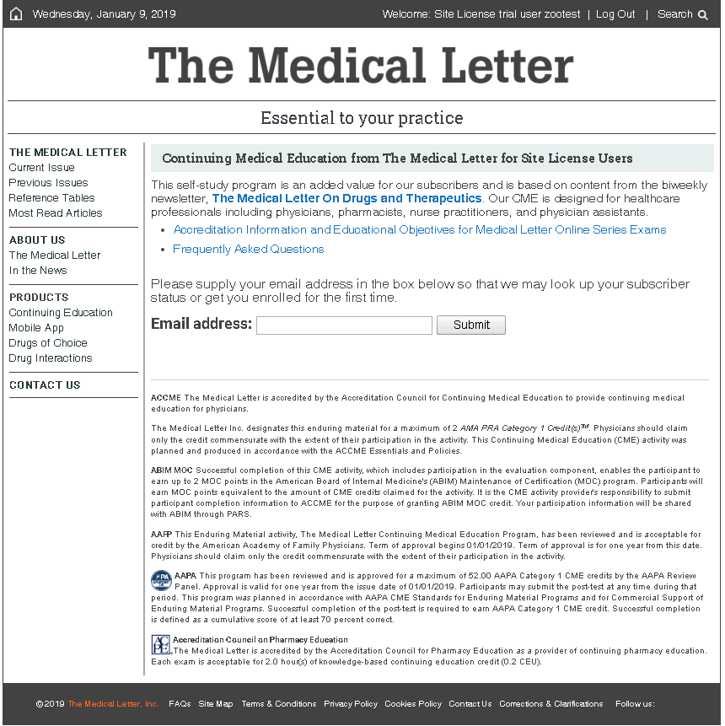
Essential #3: Continuing Medical Education
How to Enroll
Enter your email address and submit to access exams and earn CME

Slide 8




Essential #4: Mobile App
Experience your Medical Letter subscription any way you want. Access our content on the go! Anytime... Anywhere.
2 Easy Steps:
1. Download the app from:
2. Register on your site’s
Gateway Home Page

Slide 9

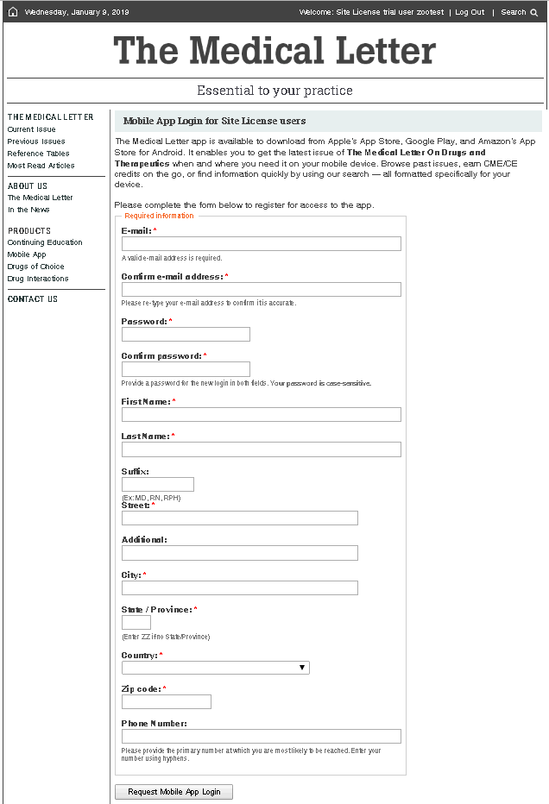
Mobile App Registration Process
Select Mobile App
Site License Gateway
Complete Form & Request Mobile App Login

Slide 10
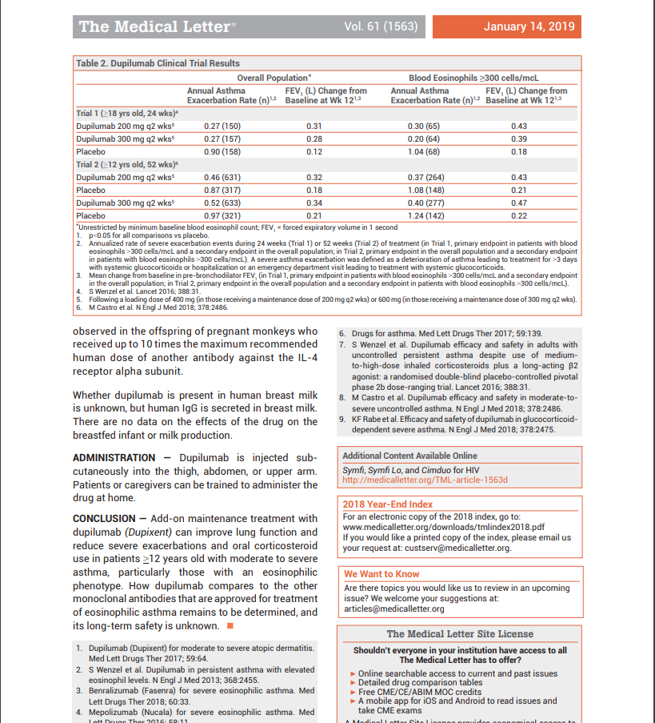
Essential #5: Conclusions
Evidence-based, peer-reviewed evaluations and recommendations reached by a consensus of experts
Providing healthcare professionals
with unbiased, time-saving
recommendations to improve
prescribing for better outcomes.

Slide 11
Questions?
For questions or additional information on optional product you can add to your current Medical Letter content, please contact:
Elaine Reaney-Tomaselli
Email: elaine@medicalletter.org

