Slide 1
Information Literacy & Library Research
Teaching Students How to Conduct Credible Research

Slide 2
Introduction
This workshop was developed to make faculty and staff aware of the importance of Information Literacy in our classrooms. The whole process of teaching students how to find, evaluate and use these resources is what is meant by becoming information literate.

Slide 3
What is Information Literacy?
Although some of the Information Literacy standards were updated by ACRL in 2015, the basic definition remains essentially the same:
Helping students to become information literate is showing them how to find, evaluate and use information in a responsible and ethical manner. This includes instructing students on where to locate valid sources from databases, the library catalog and other sources; helping them learn to determine what information is reliable and how to give proper credit to the intellectual property of others.

Slide 4
Why is Information Literacy So Important Today?
Just as people need to become literate by knowing how to read and write, it is imperative that students be able to know where to find information and how to use it to become information literate. Information Literacy is now a necessity for students and adults in this age of information.
As we know, information is abundant on the Internet, but if someone does not know how to find it, the information will be useless to them. If they cannot find a search engine and do not know how to put in search terms, they will be unable to access any information.
The same is true with print resources. If a student does not learn how to use search tools and methods in the library catalog, they will not be able to access the books they need. Imagine trying to find a book in our library by just going from shelf to shelf looking for a title!
Information Literacy will also help students evaluate the information they find.

Slide 5
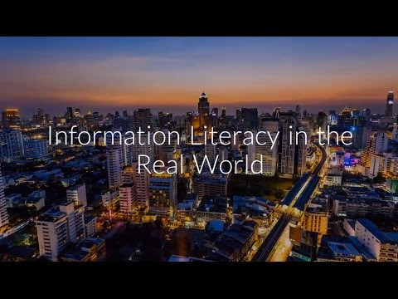
Here is a short video discussing our responsibility as purveyors of information

Slide 6
Linear Process in Researchin research
The ACRL recognizes five stages of progression in the research process typically recognizes five stages in the research process
Identify
Locate
Comprehend
Evaluate
Present

Slide 7
How to Search the Library Catalog and Databases
The library catalog features our print collections and the Alabama Virtual Library or AVL and ProQuest Newsstream, the latter two which contain our research databases. In searching the Catalog, simply put in a book title, author name or keyword search term relating to your topic. Books will appear showing a full-color book cover and other details, compliments of Content Cafe.
In the Alabama Virtual Library, there are currently 60 databases. Some are subject specific (medical, literary, business, etc.) while others are general information sources. Academic Search Complete and Gale Power Search are two good wide-ranging subject databases.
ProQuest Newsstream, a newspaper database located in Canvas, provides hundreds of national and international news sources.

Slide 8
Why Not Just Use the Internet for Research?
The Internet is an unending source of information but it is not necessarily the best source. Many web page articles have no publication date or author listed and there is no way to authenticate the validity of the information.
Information in database sources is generally full text and typically peer-reviewed. This type of source tells students that other researchers have validated the research which makes it a credible source to use.
In our database collection, there are thousands of resources available. These are the kinds of valid resources that students need to be encouraged to find and use.

Slide 9
Giving Proper Credit in Your Research
Finally, students must know the importance of being intellectually honest when using another researcher’s information. They should be taught to NEVER plagiarize the material of others. Plagiarism is simply the theft of intellectual property and proper credit must be attributed.
In giving credit to others, citations must be used. Whether a quotation is borrowed or portions of text are paraphrased, students must follow the protocol for citing it!

Slide 10
Are there any questions?
Reminder: The library staff is always available to assist students or faculty with any questions about information literacy or research related to library resources.
In addition, we would be glad to schedule an information literacy workshop for the students in your classroom.
Revised 3/28/19

