Slide 1
What is Information Literacy and Why Should It Matter to Me?
Learning How to Use Digital Information Resources in the 21st Century

Slide 2
Introduction
This PowerPoint presentation was developed for anyone who needs help learning how to find and utilize print or electronic resources for school or personal use.
Whether you are doing serious research or just learning how to find helpful information, these slides can give you a foundation for learning. And always remember that the library staff is available to help you when you are having difficulty finding the information that you need.

Slide 3
What is Information Literacy Anyway?
In a nutshell, Information Literacy is a term that describes how we find, evaluate and use information; and when we use the information of others, we must use it in a responsible and ethical manner.
The library provides print resources (books) and electronic resources (online databases) for students to use in researching information, but in order to use these resources effectively, we must be information literate. In other words, we must know how to search for and find information, how to determine its validity and how to attribute the use of it to the owner.

Slide 4

This is a helpful Information Literacy video on YouTube to watch by double clicking the picture below:

Slide 5
How to Become Information Literate
When we learn to read and write proficiently, we are considered “literate.” But now that we live in the information age, it is necessary to be information literate as well.
Just having a computer and being able to access the Internet does not guarantee that we can find information, or know how to evaluate and use it when we find it. So the purpose of this PowerPoint is to direct you to the library’s resources so that you can become more information literate.
In the next slide, we will be looking at specifically how to access the print resources through the library catalog.

Slide 6
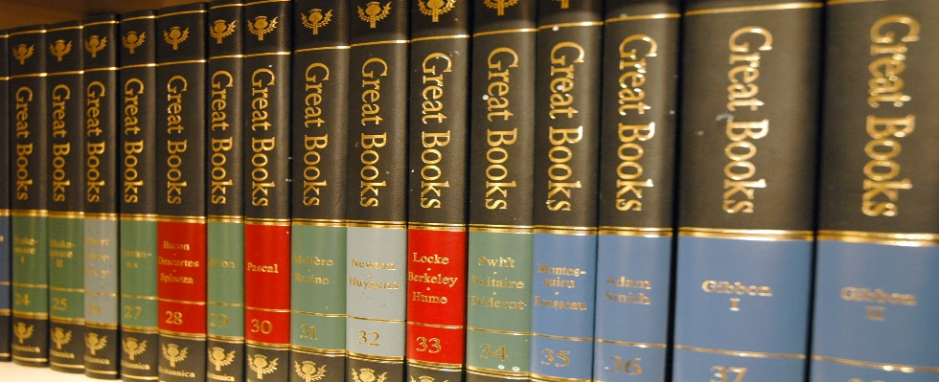
Becoming Information Literate with Print Resources
To find print resources, go to the “Student Services” tab at the top of the J. F. Drake Community and Technical College home page. Scroll down and click on the S.C. O’Neal Sr. Library and Technology Center. Next, select the “Online Library Catalog” link in the left column and then click the “Encore Search” link to initiate a search. You may search by book title, author’s name or keyword in the search box.
A list of books fitting the search term(s) will appear displaying the book’s cover in full color and a summary of the book as well as other details.
Next, we will be looking at how to access the electronic resources.

Slide 7

Becoming Information Literate with Electronic Resources
The electronic resources are also accessed in Library Services by selecting the “Alabama Virtual Library (AVL)” link. Click the red AVL link on that page and when the database page opens, select “View All Resources” tab at the top of the page. It contains 60 databases, some which are subject specific and others that are general information sources.
Subject specific databases are those that basically cover one area of study such as nursing & medicine, education, business, etc. Academic Search Premier and Gale Power Search are two general databases covering thousands of different topics and publications in a single database.
Within each database is a search platform with an option to use one or more search terms with Boolean operators and search limiters. There is even an option to search by publication if you are looking for a specific journal or periodical.

Slide 8
Why Use Database Information for Research?
Why? Because good, valid research requires peer-reviewed material in full text. Peer-reviewed simply means that other researchers have validated that research to make it a credible resource to use. Full text is the complete text of the article as it appears in the publication you are accessing.
In our database collection, there are thousands of resources available, which include periodicals, journals and newspapers. These are the kinds of valid resources that you need to be using when conducting research for course papers.

Slide 9

Giving Proper Credit in Your Research
Finally, it is important to be intellectually honest and ethical when using another researcher’s information. In other words, NEVER plagiarize, or use someone else’s material without acknowledging whose it is and where it came from.
Citations must be used to give credit for the intellectual property of others. Whenever a direct quotation is used or portions of text are paraphrased or put in your own words, that material still must be cited!
NOTE: The library staff can provide personal assistance and handouts to help students set up citations and bibliographies for their papers. Simply come to the Reference Desk and request a handout.

Slide 10
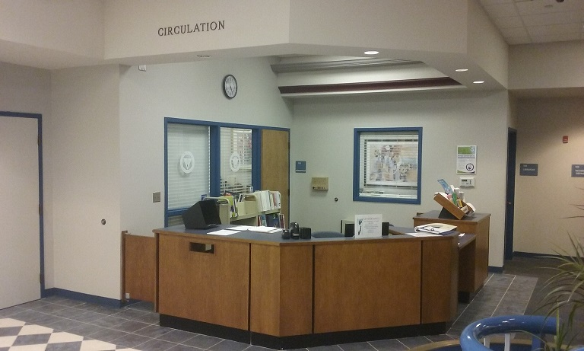
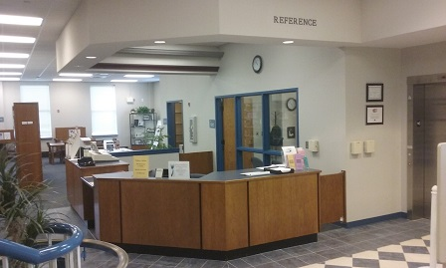
Are There Any Questions?
The library staff is available to answer any questions regarding research and information literacy. If you need assistance, please request help at the Library’s Reference or Circulation desk.
Revised 3/28/19

